Slide 1
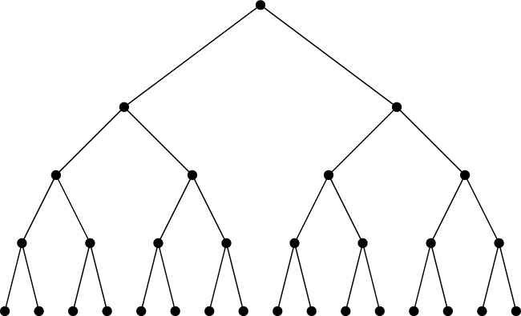






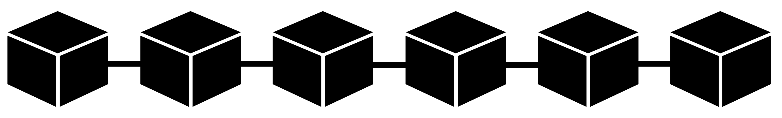




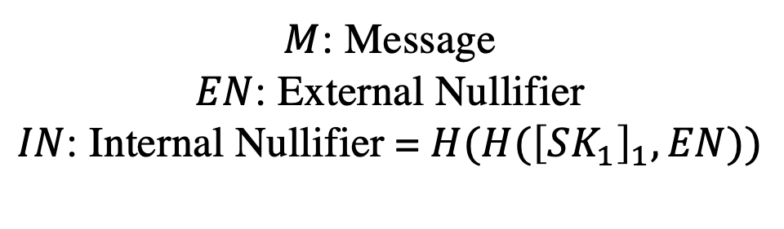

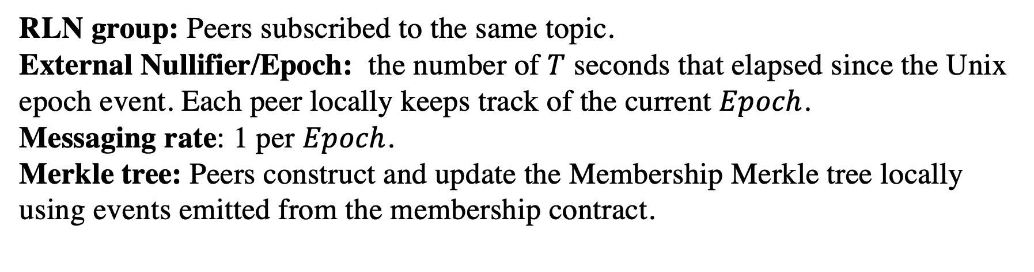

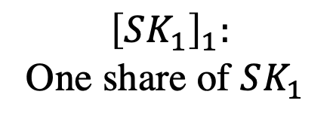




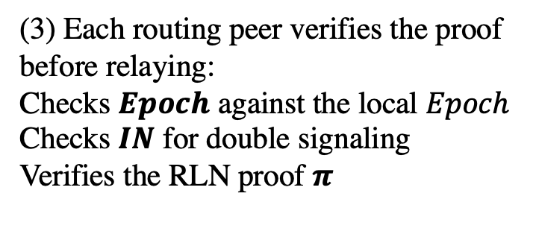


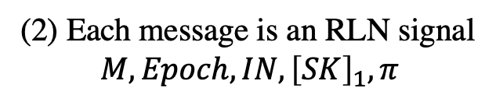
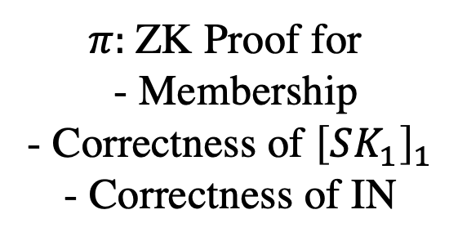

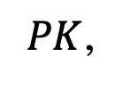
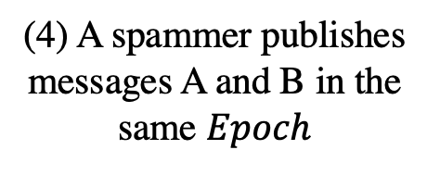

Privacy-Preserving Spam-Protected Gossip-Based Routing
Sanaz Taheri
Vac Research and Development
sanaz@status.im
Oskar Thoren
Vac Research and Development
oskar@status.im
Barry Whitehat
Unaffiliated
barrywhitehat@protonmail.com
Wei Jie Koh
Independent
contact@kohweijie.com
Onur Kilic
Unaffiliated
onurkilic@protonmail.com
Kobi Gurkan
cLabs
me@kobi.one
WAKU-RELAY: Anonymous P2P Gossip-Based Routing
Rate Limiting Nullifier
Anonymous Signaling
WAKU-RELAY [1] follows a publisher-subscriber messaging model with gossip-based routing (extension of libp2p GossipSub-v1.1 [2]).
Messages are anonymous i.e. protocol message headers carry no personally identifiable information about the message origin.
RLN membership group:
Merkle tree
$$SK_{1}, PK_{1} = H(SK_{1})$$
Anonymous No IP, No PeerID
Shamir Secret Sharing
zkSNARKs
$$PK_{1}$$
$$PK_{16}$$
$${\left[SK_{1}\right]}_{1}:$$
One share of $SK_{1}$
$π:$ZK Proof for
- Membership
- Correctness of ${\left[SK_{1}\right]}_{1}$
- Correctness of IN
$M$: Message
$EN$: External Nullifier
$IN$: Internal Nullifier = $H(H({\left[SK_{1}\right]}_{1},EN))$
Spam and Denial-of-Service Attack
We define spammers as entities that publish a large number of messages in a short amount of time, and cause Denial-of-Service.
Spam Protection = Controlled Messaging Rate
Double Signaling and Slashing
$$SK_{1}, PK_{1} = H(SK_{1})$$
Spammer
$$M, EN, IN, {\left[SK_{1}\right]}_{1}, π$$
$$M’, EN, IN, {\left[SK_{1}\right]}_{2}, π′$$
$$PK_{1}$$
$$PK_{16}$$
Secret Construct
$$PK_{1} = H(SK_{1})$$
$$SK_{1}$$
Global Spam Protection and Anonymity
Routing Protocol Construction
Routing peers can not distinguish between spam messages and non-spam messages.
Solutions like IP blocking are not effective.
RLN group: Peers subscribed to the same topic.
External Nullifier/Epoch: the number of $T$ seconds that elapsed since the Unix epoch event. Each peer locally keeps track of the current $Epoch$.
Messaging rate: 1 per $Epoch$.
Merkle tree: Peers construct and update the Membership Merkle tree locally using events emitted from the membership contract.
Spammer
Publisher
Messages are anonymous and unlinkable!
Routing peer
(1) A publishing peer registers to the group and locks some funds
Membership Contract $PK_{1}$,…, $PK_{n}$
State-of-the-art Spam Protection Methods
$PK$,
(6) The routing peer recovers the spammer’s secret key, withdraws its funds and removes it from the group
Proof-of-work [3] deployed by Whisper [4]
Computationally expensive
Not suitable for network of heterogeneous peers with limited resources
Peer Scoring [2] in libp2p
Local to each peer
No global identification of spammer
Subject to inexpensive attacks using bots
(2) Each message is an RLN signal
$$M, Epoch, IN, {\left[SK\right]}_{1}, π$$
…
A
A
(3) Each routing peer verifies the proof before relaying:
Checks $Epoch$ against the local $Epoch$
Checks $IN$ for double signaling
Verifies the RLN proof $π$
(4) A spammer publishes messages A and B in the same $Epoch$
B
(5) The routing peer identifies message B as a spam and does not relay.
Future Works
WAKU-RLN-RELAY: Anonymous and P2P Global Spam Protection Made Possible
Benchmarking
Efficient Merkle tree maintenance
  P2P network of full-nodes and light-nodes
  Partial view of Merkle tree
Real-time removal of spammers using off-chain/p2p solutions
Cost-effective way of member insertion and deletion using layer 2 solutions
WAKU-RLN-RELAY [6] features an Efficient & Anonymous P2P Global Spam Protection by integrating the novel construct of Rate Limiting Nullifiers (RLN) [5] into the WAKU-RELAY protocol. The final result is a spam-protected gossip-based routing protocol that additionally provides:
A protocol-level solution
Sybil attack mitigation
Built-in economic incentives where spammers are financially punished and those who find spammers are rewarded
References
WAKU-RELAY specifications, https://rfc.vac.dev/spec/11
Vyzovitis D, Napora Y, McCormick D, Dias D, Psaras Y. GossipSub: Attack-resilient message propagation in the Filecoin and ETH2. 0 networks. arXiv preprint arXiv:2007.02754. 2020 Jul 6.
C. Dwork and M. Naor, “Pricing via processing or combatting junk mail,” in Annual international cryptology conference. Springer, 1992.
Whisper https://eips.ethereum.org/eips/eip-627
RLN specifications, https://rfc.vac.dev/spec/32
WAKU-RLN-RELAY specifications, https://rfc.vac.dev/spec/17

